Slide 1
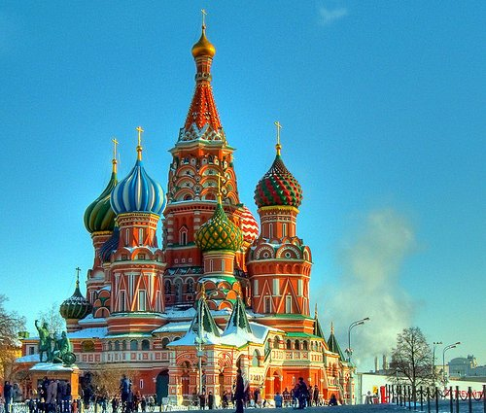
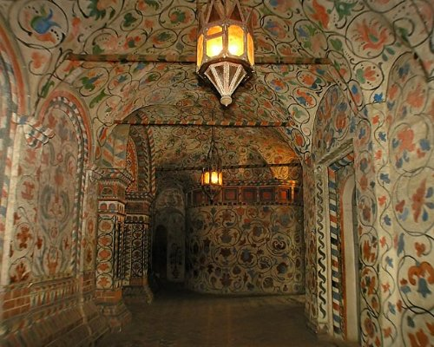

유럽의 아름다운 성당 79곳
St. Basil’s Cathedral, Moscow (Russia)

Slide 2
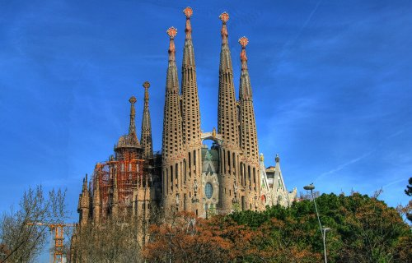
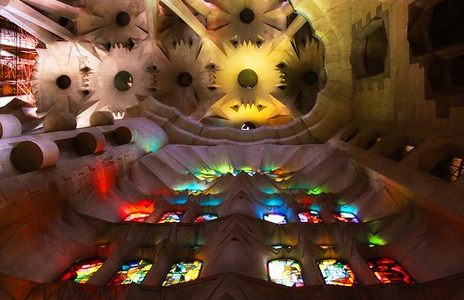
Sagrada Familia, Barcelona (Spain)

Slide 3
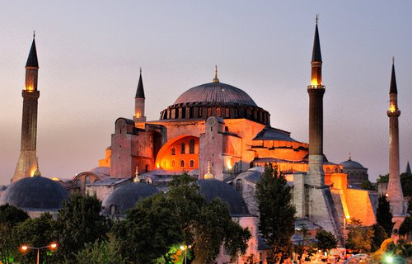
Hagia Sophia, Istanbul (Turkije)

Slide 4
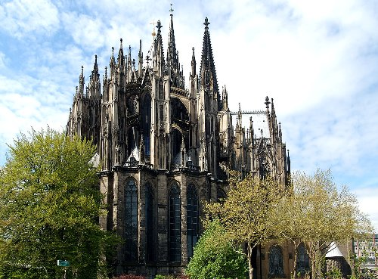
Keulner Dom, Cologne (Germany)

Slide 5
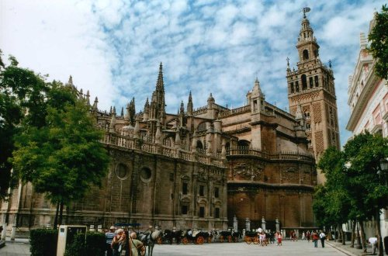
Catedral de Santa Maria de la Sede, Sevilla (Spain)

Slide 6
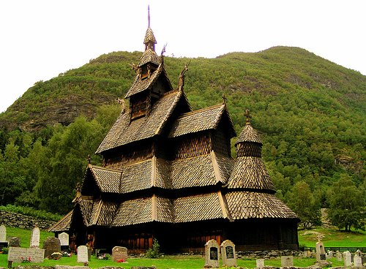
Borgund stavkirke, Borgund (Norway)

Slide 7
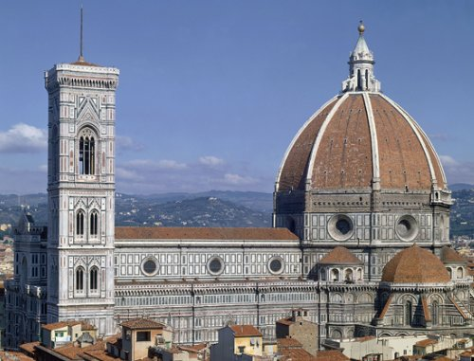
Basilica di Santa Maria del Fiore, Florence (Italy)

Slide 8
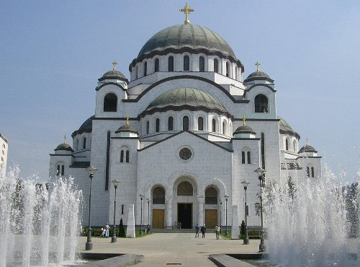
St. Sava Cathedral, Belgrade(Serbia)

Slide 9
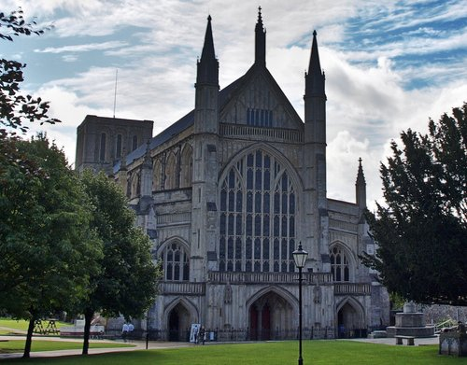
Winchester Cathedral, Winchester (England)

Slide 10
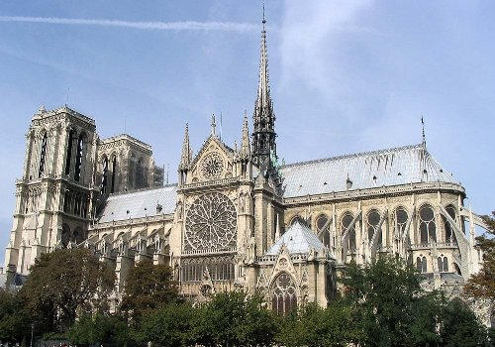
Notre Dame, Paris (France)

Slide 11
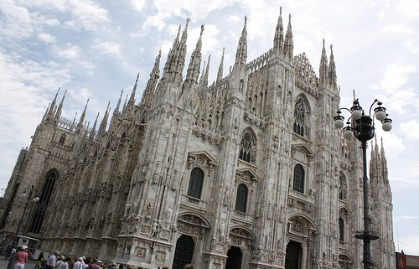
Duomo, Milan (Italy)

Slide 12
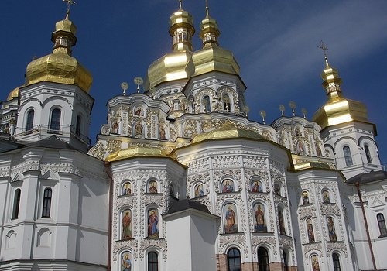
Pechersk Lavra, Kiev (Ukraine)

Slide 13
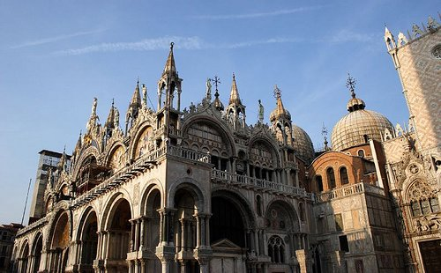
Basilica di San Marco, Venice (Italy)

Slide 14
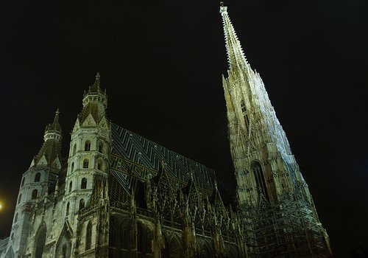
St. Stephen’s Cathedral, Wenen (Austria)

Slide 15
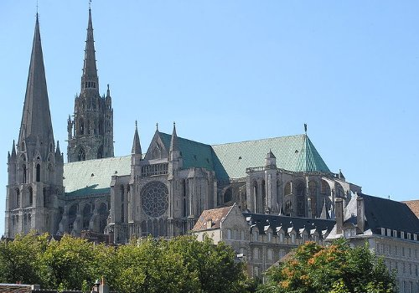
Chartres Cathedral, Chartres (France)

Slide 16
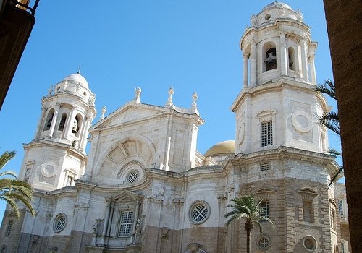
Cadiz Cathedral, Cadiz (Spain)

Slide 17
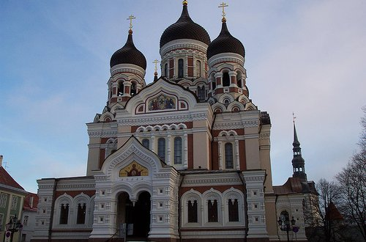
Alexander Nevsky Cathedral, Tallinn (Estonia)

Slide 18
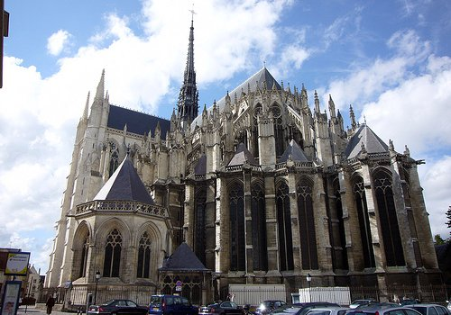
Notre-Dame of Amiens, Amiens (France)

Slide 19
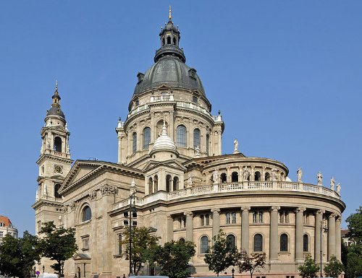
St. Stephen’s Basilica, Budapest
(Hungary)

Slide 20
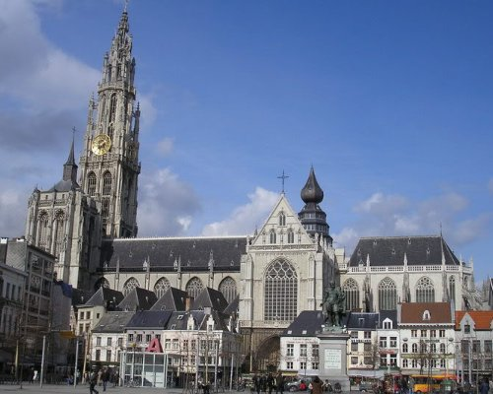
Cathedral of Our Lady, Antwerp (Belgium)

Slide 21
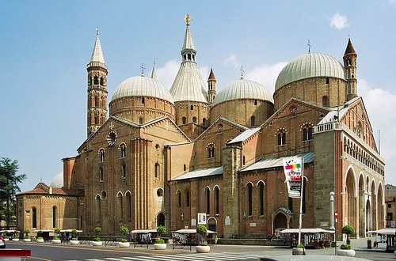
Basilica di Sant’Antonio, Padova (Italy)

Slide 22
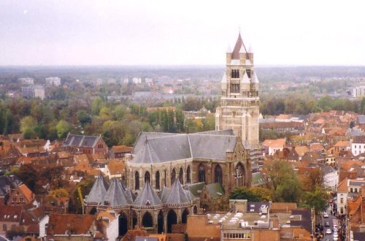
Bruges Cathedral, Bruges (Belgium)

Slide 23
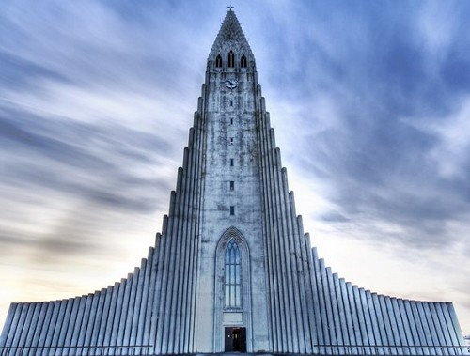
Hallgrimur Church, Reykjavik
(Iceland)

Slide 24
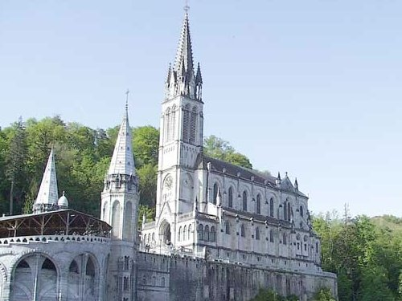
Notre-Dame de l’Immaculee-Conception, Lourdes (France)

Slide 25
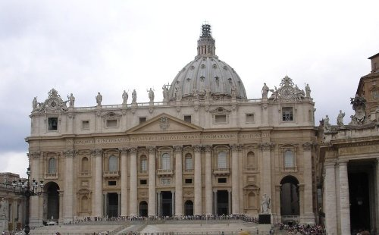
Basilica di San Pietro, Vatican City

Slide 26
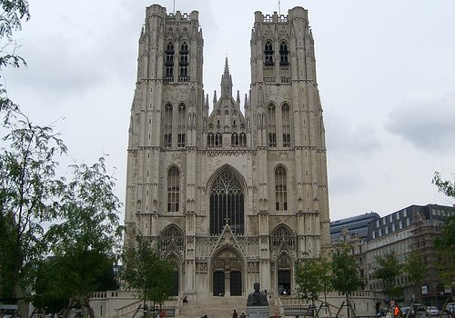
St. Michael and St. Gudula Cathedral, Brussels (Belgium)

Slide 27
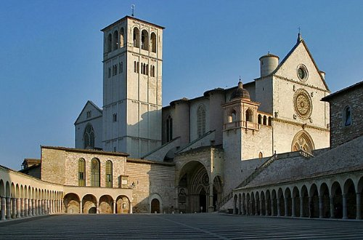
Basilica of San Francesco d’Assisi, Assisi (Italy)

Slide 28
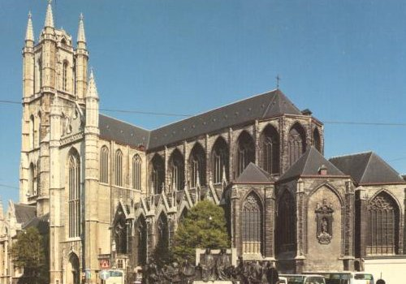
Saint Bavo Cathedral, Ghent (Belgium)

Slide 29
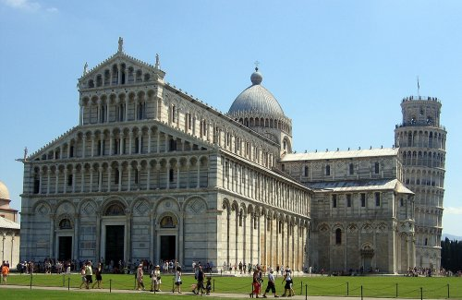
Duomo Santa Maria, Pisa (Italy)

Slide 30
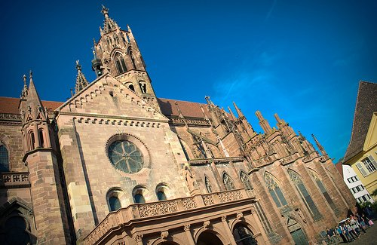
Munster Unserer Lieben Frau, Freiburg (Germany)

Slide 31
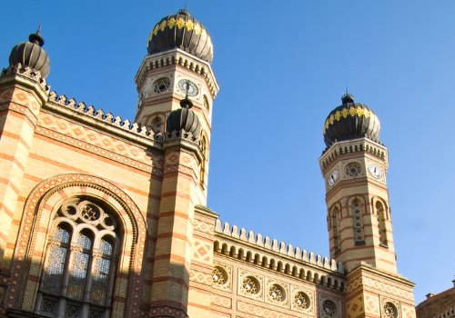
Nagy Zsinagoga, Budapest (Hungary)

Slide 32
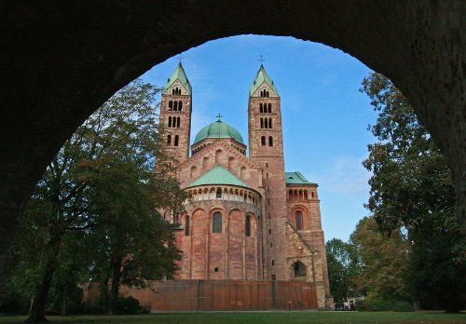
Speyer Dom, Speyer (Germany)

Slide 33
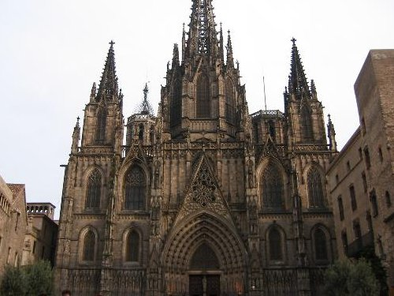
Catedral de Santa Eulalia, Barcelona (Spain)

Slide 34
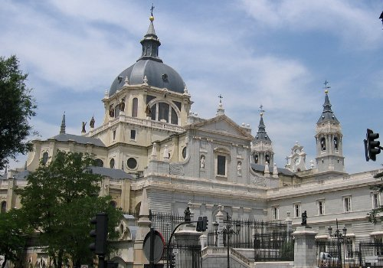
Santa Maria la Real de La Almudena, Madrid (Spain)

Slide 35
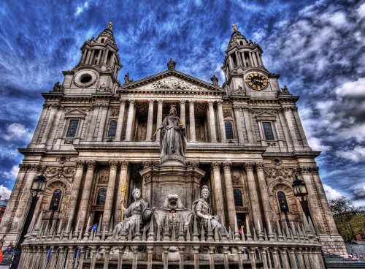
St Paul’s Cathedral, London (England)

Slide 36
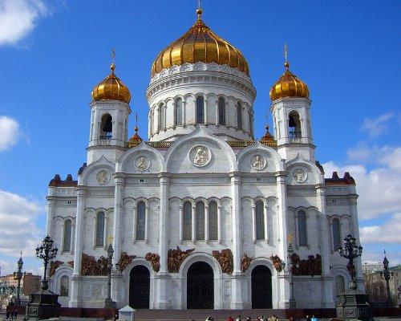
Cathedral of Christ the Saviour, Moscow (Russia)

Slide 37
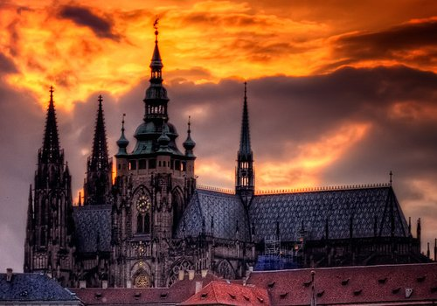
St. Vitus Cathedral, Prague (Czech Republic)

Slide 38
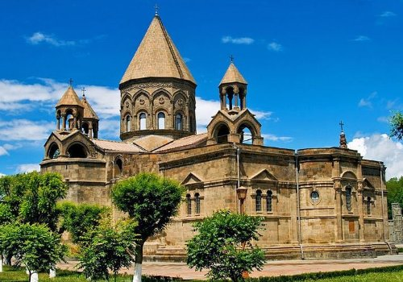
Echmiatsin Cathedral, Echmiatsin (Armenia)

Slide 39
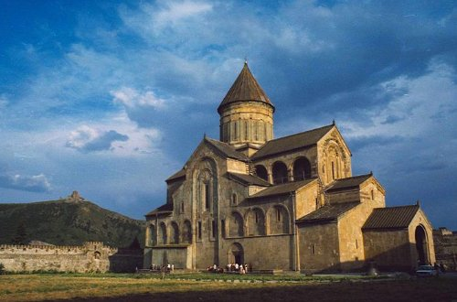
Svetitskhoveli Cathedral, Mtscheta (Georgia)

Slide 40
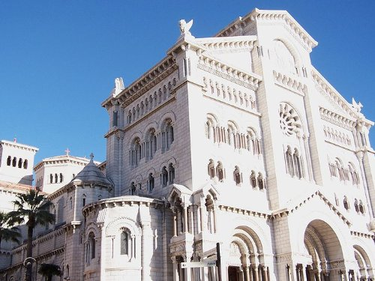
Cathedrale Notre-Dame-Immacul?e, Monaco (Monaco)

Slide 41
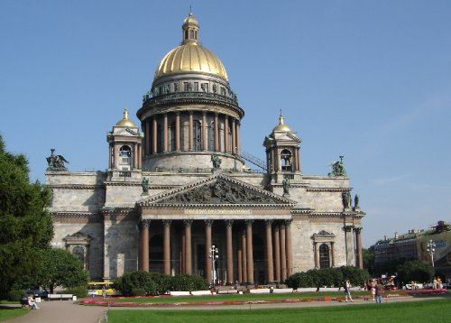
Saint Isaac’s Cathedral, Saint Petersburg (Russia)

Slide 42
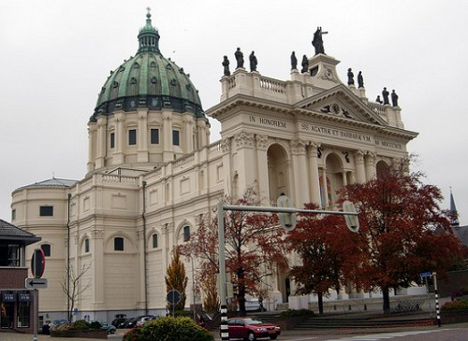
Oudenbosch Basilica, Oudenbosch (The Netherlands)

Slide 43
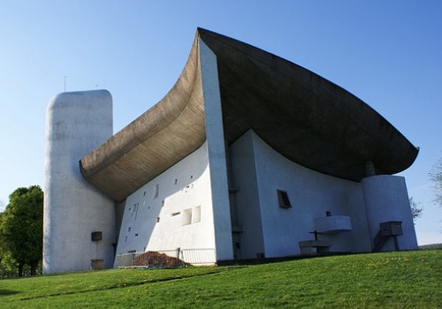
Notre Dame du Haut, Ronchamp (France)

Slide 44
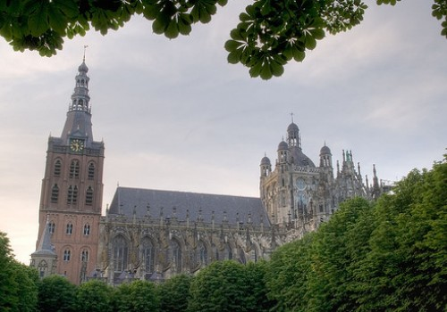
Saint John’s Cathedral, Den Bosch (The Netherlands)

Slide 45
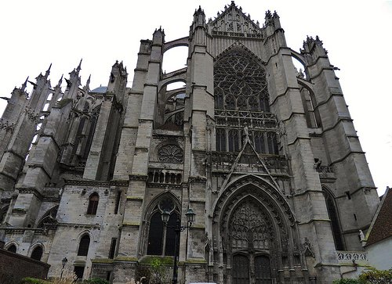
Beauvais Cathedral, Beauvais (France)

Slide 46
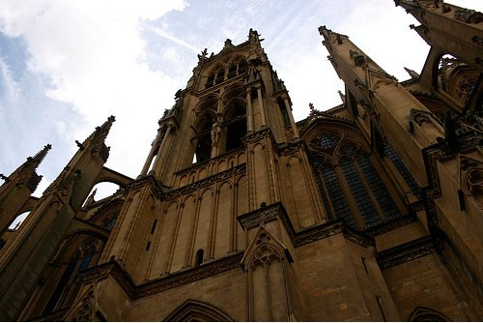
Cathedrale Saint-?tienne de Metz, Metz (France)

Slide 47
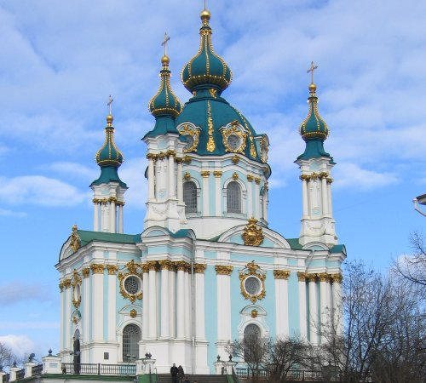
St. Andrew’s Church, Kiev (Ukraine)

Slide 48
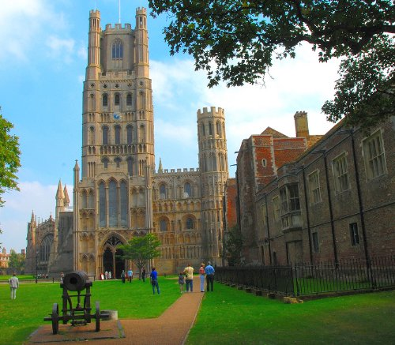
Ely Cathedral, Cambridgeshire (England)

Slide 49

Ulm Cathedral, Ulm (Germany)

Slide 50

Temppeliaukion Kirkko, Helsinki (Finland)

Slide 51

Utrecht Cathedral, Utrecht (The Netherlands)

Slide 52

Riga Cathedral, Riga (Latvia)

Slide 53

Santuario di San Besso, Ronco Canavese (Italy)

Slide 54

Basilica of Sts. Stanisław and Vaclav, Krak?w (Poland)

Slide 55

Westminster Abbey, London (England)

Slide 56

Basilique du Sacr?-Coeur de Montmartre, Paris (France)

Slide 57

Mosteiro dos Jeronimos, Lisbon (Portugal)

Slide 58

Aglona Basilica, Aglona (Latvia)

Slide 59

Meteora, Kalambaka (Greece)

Slide 60

Le Mont Saint-Michel, Normandy (France)

Slide 61

Chiesa di Dio Padre Misericordioso, Rome (Italy)

Slide 62

Liverpool Metropolitan Cathedral, Liverpool (England)

Slide 63

Catedral de Leon, Leon (Spain)

Slide 64

Taidekappeli, Turku (Finland)

Slide 65

Wieskirche, Wies (Germany)

Slide 66

Durham Cathedral, Durham (England)

Slide 67

St. Stephan’s Church, Istanbul (Turkey)

Slide 68

St. Mark’s Church, Belgrade (Serbia)

Slide 69

Nidaros Cathedral, Trondheim (Norway)

Slide 70

Burgos Cathedral, Burgos (Spain)

Slide 71

St. Bavochurch, Haarlem (The Netherlands)

Slide 72

Bremilham church, Malmesbury (England)

Slide 73

Saint Sophia Cathedral, Kiev (Ukraine)

Slide 74

Sveti Jovan Kaneo, Ohrid (Macedonia)

Slide 75

Stavanger domkirke, Stavanger (Norway)

Slide 76

Kizhi Pogost, Kizhi (Russia)

Slide 77

Esztergomi Bazilika, Esztergom (Hungary)

Slide 78

Asamkirche, Munich (Germany)

Slide 79

Graun Tower, Lago di Resia (Italy)

Slide 80


대한민국 서울 명동 성당(1898.5.28)
END

